Slide 1
Amendment to the Ordinance Regulating the Siting of Wind Energy Conversion Systems
Christian County, IL
Zoning Board of Appeals
June 23rd 2020

Slide 2
Applicants
City of Roses Wind Energy LLC
235 MW Project
Located in southeast Christian County
$300M estimated cost
$50M estimated taxes paid over project life

Slide 3
Applicants
Rolling Farms Wind Project LLC
200 MW Project
Located in southeast Christian County
$250M estimated cost
$45M estimated taxes paid over project life

Slide 4
Summary of Text Amendments
Section V:
- Require WECS Project applicants to enter into the AIMA with Illinois Department of Agriculture
Section VI:
- Require that final turbine locations comply with applicable FAA regulations
- Increase the Primary Structure setback from 1,000 feet to 1,500 feet
- Increase maximum turbine height from 450 feet to 660 feet, which will allow wind energy projects to utilize modern turbines with increased nameplate capacity and decrease the number of turbines required for a project
- Limit wind energy projects to 30 hours of annual shadow flicker in non-participating Primary Structures
Section XII:
- Clarify requirements for calculating the amount of financial security for decommissioning and to require that the amount of decommissioning security be posted in accordance with the AIMA and updated every five years

Slide 5
Turbine Height
Turbines are getting taller and more efficient as technology evolves
Benefits of increased turbine height:
Larger nameplate capacity – more MW per turbine
Less turbines installed
State of the art design
Same tax benefits

Slide 6
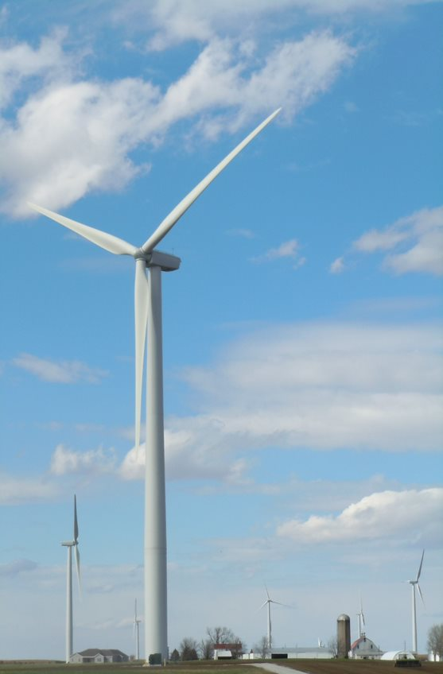
Setbacks
Current setback from residences is 1,000ft
Proposing a setback of 1,500ft from residences
Exceeds setback requirement of several IL Counties with operating wind farms

Slide 7
Shadow Flicker
Ordinance does not currently impose a limit
Proposing a limit of 30 hours
This is a common limit for wind farms in the US

Slide 8
Other proposed text amendments
County Board:
ADLS mandatory
Emergency response plan and funding required
City of Roses and Rolling Farms support County Board text amendments
Zoning Administrator:
Primary Structure setback of 1,600 feet
Increase insurance amounts to $5M per occurrence and $30M aggregate
Indemnity provision
100% of Financial Assurance for Decommissioning provided at building permit
Increased building permit fees
PCC:
City of Roses and Rolling Farms generally object to the PCC text amendments
Moratorium request unnecessary and moot

Slide 9
Application Request
Recommendation to County Board to incorporate the proposed amendments into the Ordinance Regulating the Siting of Wind Energy Conversion Systems

